Slide 1

After Life
(Management of the dead and missing)
Lee, kyle Vincent v. reyes, Hannah mae e. mi – 141

Slide 2
Introduction
Management of the Dead and Missing Cluster
Response Team
Department of Interior and Local Government
An app that aims to help people search and identify missing persons and dead bodies

Slide 3
Current Process
Proposed Process
Search and Recovery Operation
Identification of the Dead
Final Arrangement for the Dead
Management of the Missing Persons
Management of Bereaved Families
Identification of the Dead
Search Function
Management of the Missing Persons

Slide 4
Objectives
Mission of the NDRRMC
To provide assistance in the proper identification and disposition of the remains in a sanitary manner with cautions to prevent negative psychological and social impact on the bereaved and the community.
App Objectives
To help identify people (dead, alive, missing, found)
To easily monitor dead/missing people
To have an organized search operation

Slide 5
Scope
Search Operation
Identification of the Dead and Missing
Summary of all Records (List of Identified and Unidentified)
Volunteer Form
Request for Transportation of Dead Bodies
List of emergency procedures
Validation of posts
News about dead/missing
List of Near Makeshift Morgues
Desposing of Bodies
Storage

Slide 6
Limitation
Management of the Bereaved Families
More on Psycho Spiritual Integration Cluster)
Internet-based
Final Arrangement for the Dead
Issuance of Death and Missing Certificates

Slide 7
DESIGN OF PROTOTYPE

Slide 8
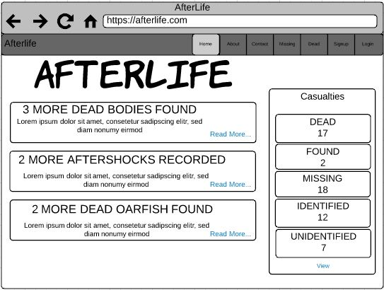

Slide 9
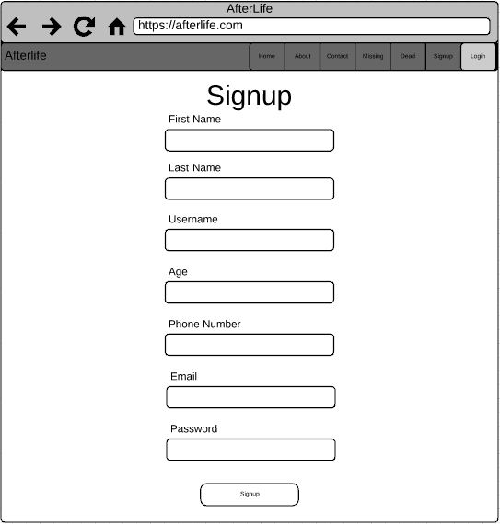

Slide 10
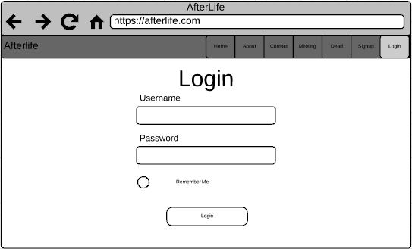

Slide 11
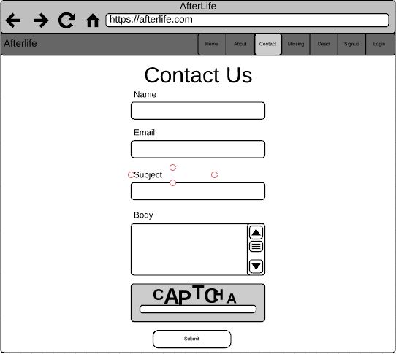

Slide 12
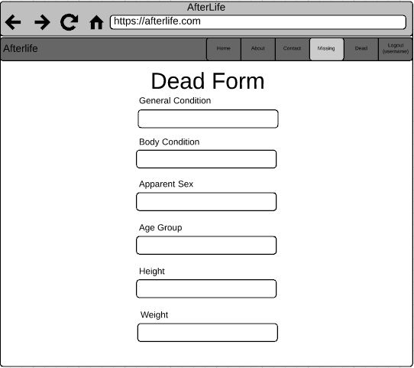

Slide 13
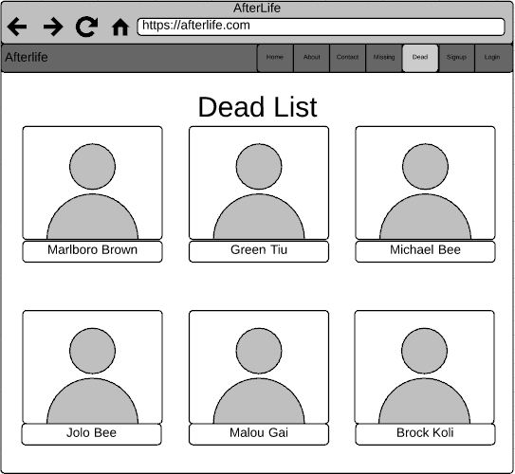

Slide 14
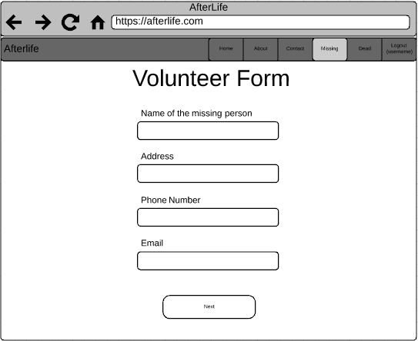

Slide 15
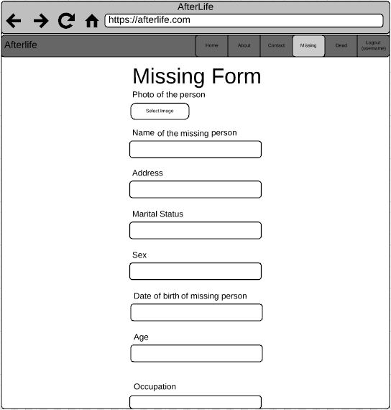

Slide 16
